Slide 1

Baldriod
Bolyai János Műszaki Technikum és Kollégium
Schuszter Zalán, Kocsis Dominik

Slide 2

Basic functions
New game, save, load
Registration, login
Admin page, edit data

Slide 3


Teamwork
Schuszter Zalán:
Frontend
Kocsis Dominik:
Backend, database
Teams Github

Slide 4
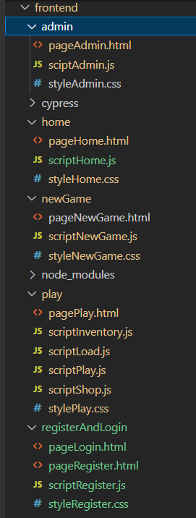

Frontend
Pages in separate folders
HTML, CSS, JS files related to the page

Slide 5
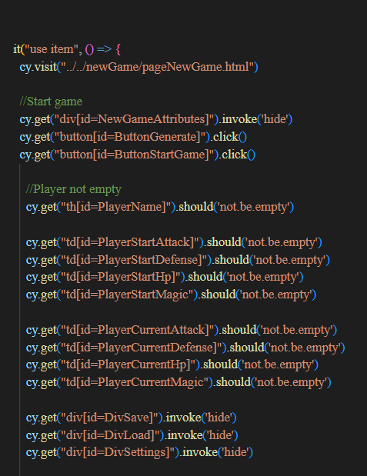

Frontend Testing
Automatic tests with Cypress

Slide 6
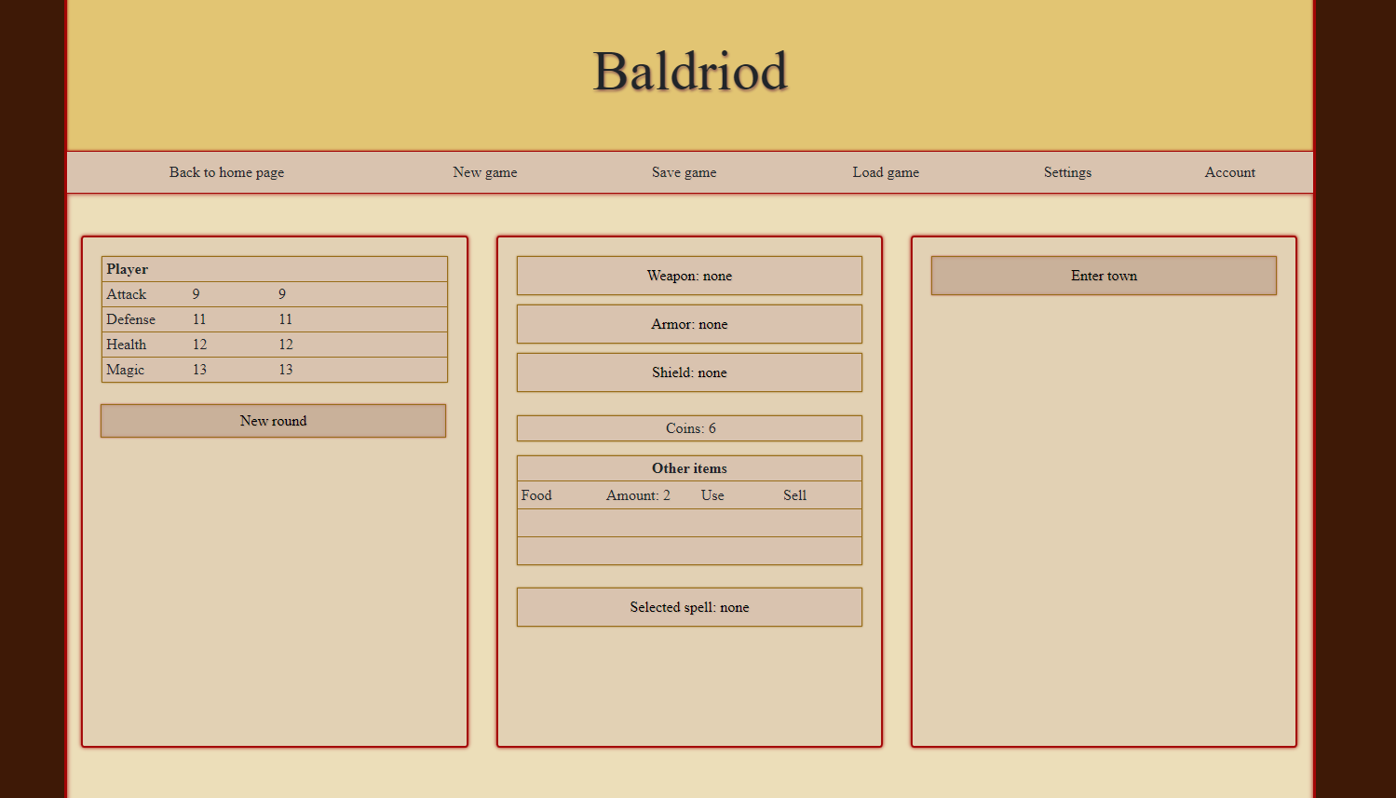
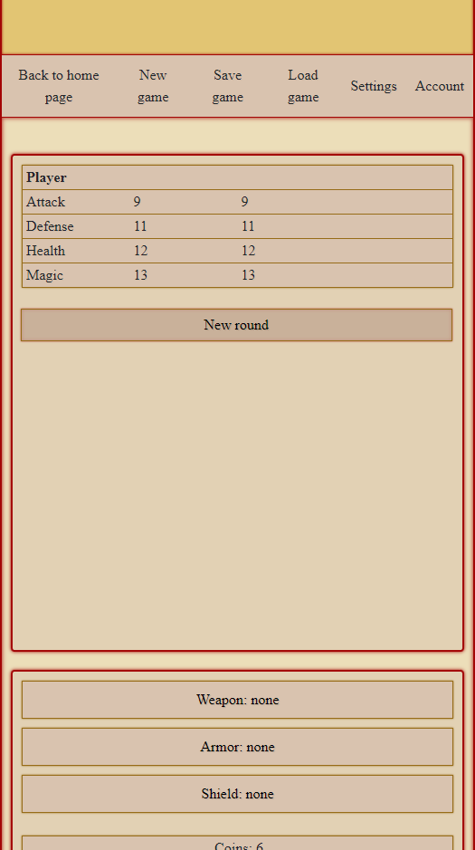
Responsivity

Slide 7

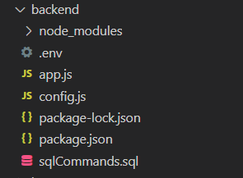
Backend
NodeJs server, express
JWT tokenisation

Slide 8
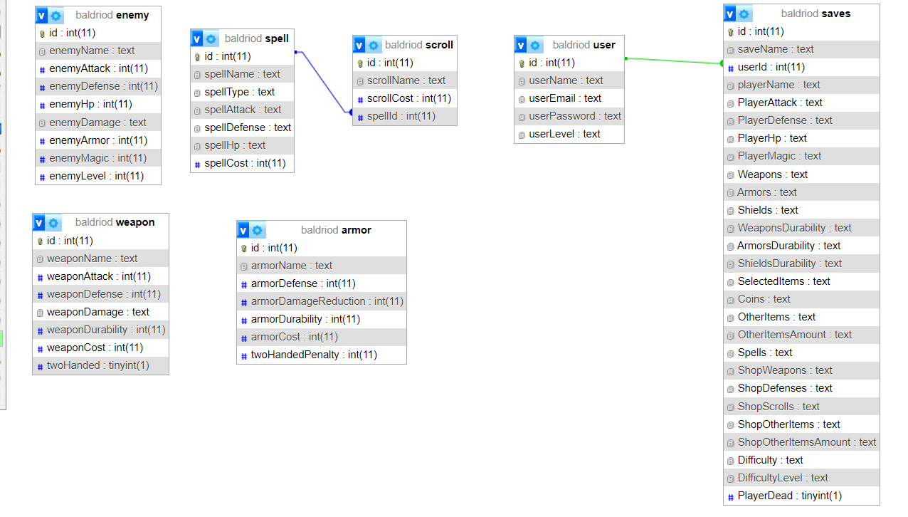

Database
Xampp
Mysql

Slide 9
Future plans
Map
Fighting with multiple enemies at the same time
Choosable language

Slide 10
Thanks for watching!

